Slide 1
Advanced Data Structure
Social Network System
(By using graph Data Structure )
Guided By : Prof. Dr. Kavita Sultanpure

Slide 2
Introduction of Group :
Sr no. | Name | Roll no. | Prn no.
1. | Maitrey Katkar | 26 | 12210893
2. | Omkar Khanvilkar | 30 | 12210313
3. | Janvi Kharat | 31 | 12210610
4. | Gita Kolate | 33 | 12210505
5. | Babusha Kolhe | 34 | 12210697

Slide 3
Content :
1
Problem Statement
2
Importance of Project
3
Why we used Graphs Data Structure
4
Algorithm/Working
5
Contribution of members
6
Conclusion/Result
7
References

Slide 4

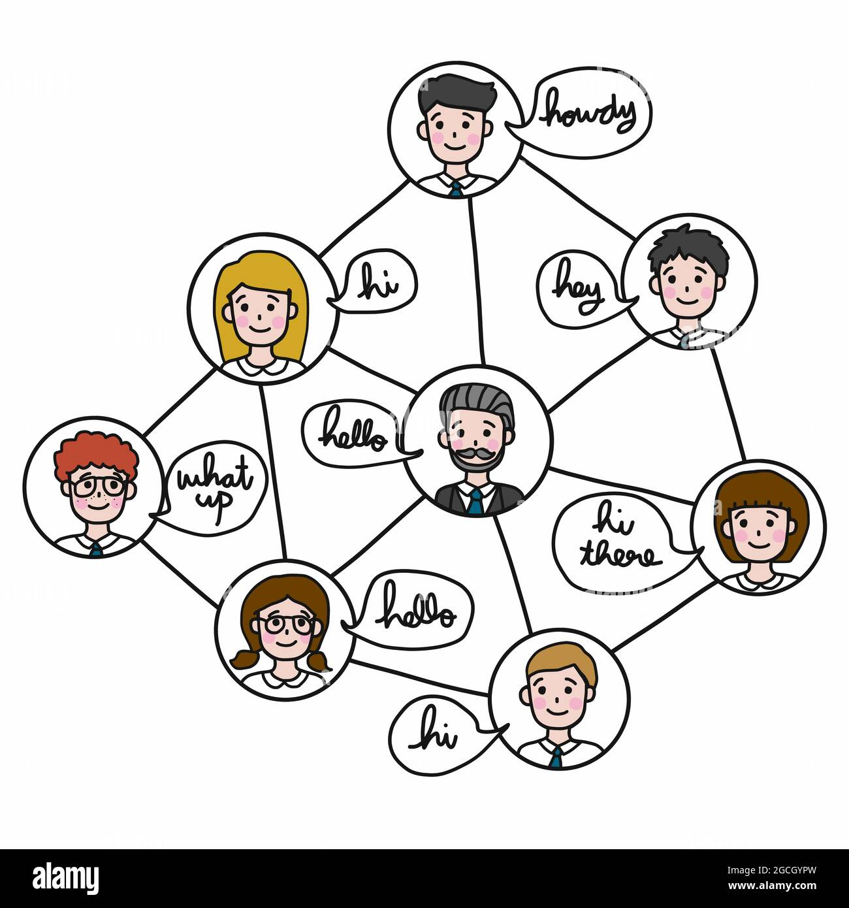
Problem Statement :
In today's digitally connected world, the need for meaningful social connections and relevant content engagement is more important. Users often struggle to find and connect with people who share their interests.
To address this challenge, we aim to develop a sophisticated friend recommendation system and social networking platform that leverages graph data structures to enhance the user experience.

Slide 5





Importance of project :
Enhanced Social Connections
Knowledge
Sharing
Community
Building
Content
Sharing
Global
Reach

Slide 6
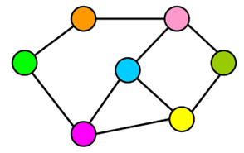
Why we used Graph Data structure?
Graph data structure is a natural fit for modeling and managing the complex web of relationships and connections in social networks
Natural Representation
Efficient Querying
Scalability
Recommendation Systems
Community Detection
Real-time Updates
Pathfinding and Navigation

Slide 7
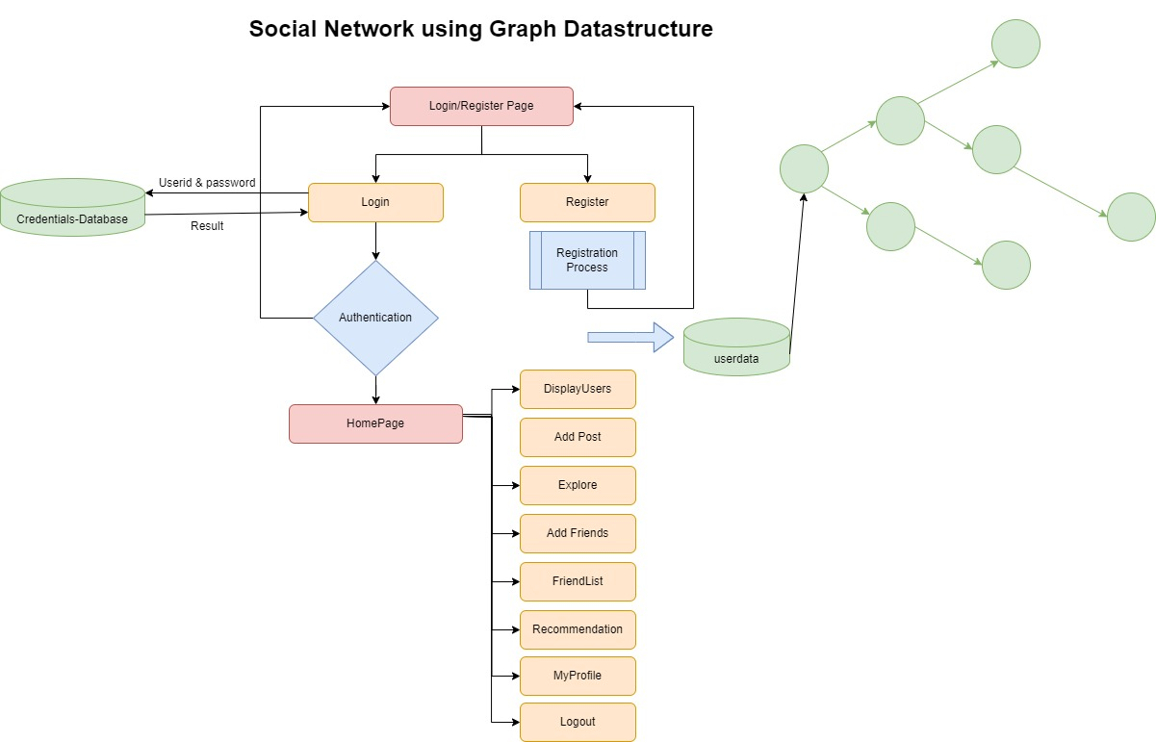

No
yes
GitHub Link

Slide 8
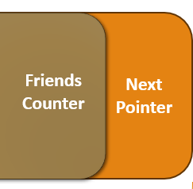
Structure of Graph node:
Graph implemented using linked list representation
F1
F2
F3
F4
F5
Friend Pointers
User Structure
User Structure
User Structure Pointer to save friends
User Structure Pointer to save friends
Friends Counter
Next Pointer
UserNode

Slide 9
Contribution In Project :
ADS Project
Recommendation/Finduserbyname/
GUI/
AddFriend/CreateNode/Login
AddPost/Register/Explore
Omkar Khanvilkar
Babusha Kolhe
Maitrey Katkar
Gita Kolate
Janvi Kharat

Slide 10

Conclusion:
Meaningful Connections
Content Engagement
Search and Discovery
System leads to great community Building
Project using graph data structure has been a valuable learning experience for the project team, demonstrating the importance of collaboration, planning, and perseverance in software development.

Slide 11
References:
https://www.javatpoint.com/ds-graph
https://www.w3schools.in/data-structures
https://youtube.com/playlist?list=PLqM7alHXFySEaZgcg7uRYJFBnYMLti-nh&feature=shared
https://youtube.com/playlist?list=PLxCzCOWd7aiG0M5FqjyoqB20Edk0tyzVt&feature=shared

Slide 12


